Slide 1
CAPSTONE Project 2
Title:- Finger Sign Detection through CNN
Presented by:- Manya Avasthy
Date:- 24/02/2024

Slide 2
Agenda
Introduction
About CNN
Overview of the Data
Quality Check
EDA(Exploratory Data Analysis)
Scaling the Data
One Hot Encoding
Creating CNN Model
Summary of Model
Accuracy and Prediction of the model
Future Scope
Conclusion

Slide 3
Introduction
Today, I'll introduce how Convolutional Neural Networks (CNNs) can understand finger signs, making communication easier for people who use sign language. CNNs are like smart detectives that analyze pictures to understand their meaning. We'll explore how CNNs learn to recognize different finger signs, including how we choose the right pictures to teach them and how we train them to be accurate.
We'll also see real-life examples of how this technology can help, like improving sign language recognition systems or creating new ways for people to interact with computers using their hands. However, we'll also discuss challenges, such as finding the right pictures and ensuring accurate recognition. Together, let's discover how CNNs can break down communication barriers and make the world more inclusive.

Slide 4
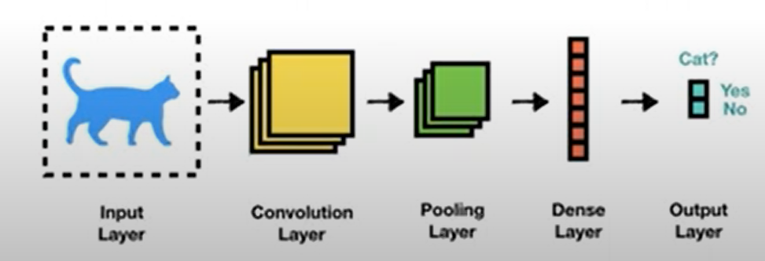
About CNN
Convolutional Neural Network is a deep learning algorithm which is used for recognizing images. This algorithm clusters images by similarity and perform object recognition within scenes. CNN uses unique feature of images (e.g. cat’s tail and ears, airplane’s wing and engine etc.) to identify object that is placed on the image.

Slide 5

Overview of the data
X_train.shape: This array has a shape of (1080, 64, 64, 3). This means it contains 1080 training examples, and each example is a 64x64x3 image (where 3 likely represents the RGB channels of an image).
Y_train.shape: This array has a shape of (1080,). This means it contains 1080 labels, one for each training example.
X_test.shape: This array has a shape of (120, 64, 64, 3). This means it contains 120 testing examples, and each example is a 64x64x3 image.
Y_test.shape: This array has a shape of (120,). This means it contains 120 labels, one for each testing example.

Slide 6
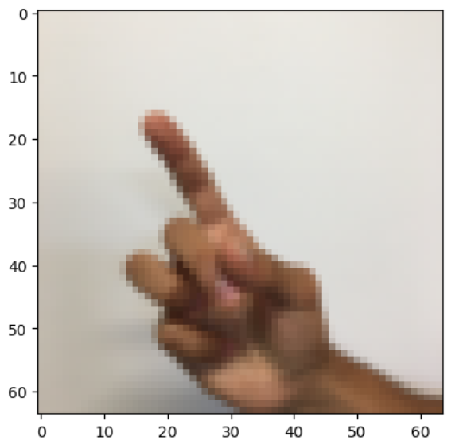
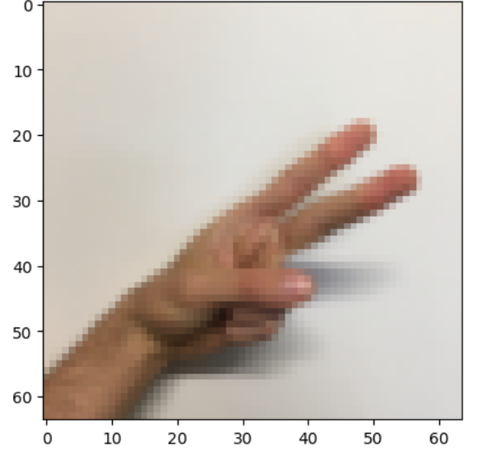
Quality Check
To check the quality of picture of specific index

Slide 7
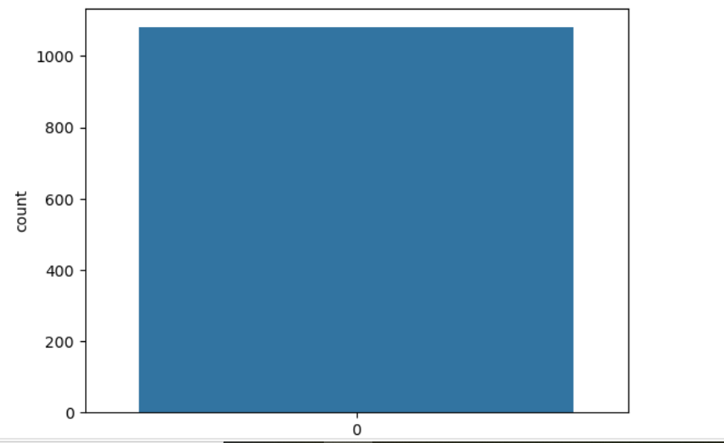
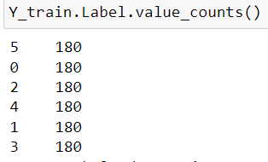
EDA(Exploratory Data Analysis)
Checking if the data is imbalanced through EDA

Slide 8
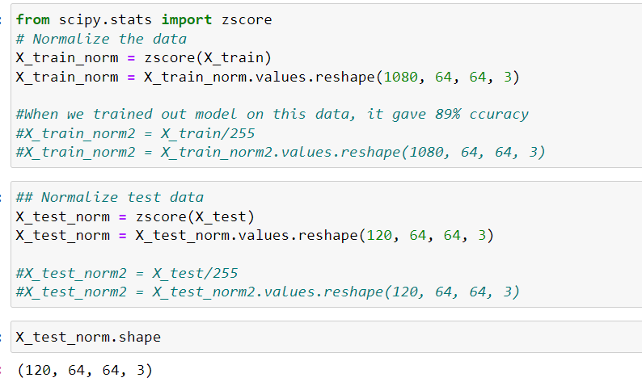
Scaling the Data
from scipy.stats import zscore: This line imports the zscore function from the scipy.stats module. This function is used to normalize data by subtracting the mean and dividing by the standard deviation.
X_train_norm = zscore(X_train): This line applies z-score normalization to the training data X_train. It subtracts the mean and divides by the standard deviation for each feature (pixel) in the dataset. The result is a normalized version of the training data.
X_test_norm = zscore(X_test): Similar to the training data, this line applies z-score normalization to the test data X_test.

Slide 9
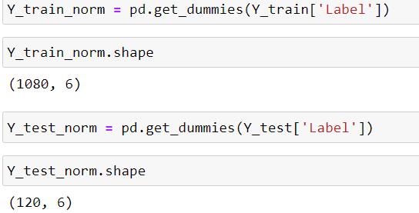
One Hot Encoding
Y_train_norm = pd.get_dummies(Y_train['Label']): This line converts the training labels Y_train['Label'] into one-hot encoded vectors using the pd.get_dummies() function from the Pandas library
Y_test_norm = pd.get_dummies(Y_test['Label']): Similar to the previous line, this line converts the test labels Y_test['Label'] into one-hot encoded vectors using pd.get_dummies().

Slide 10
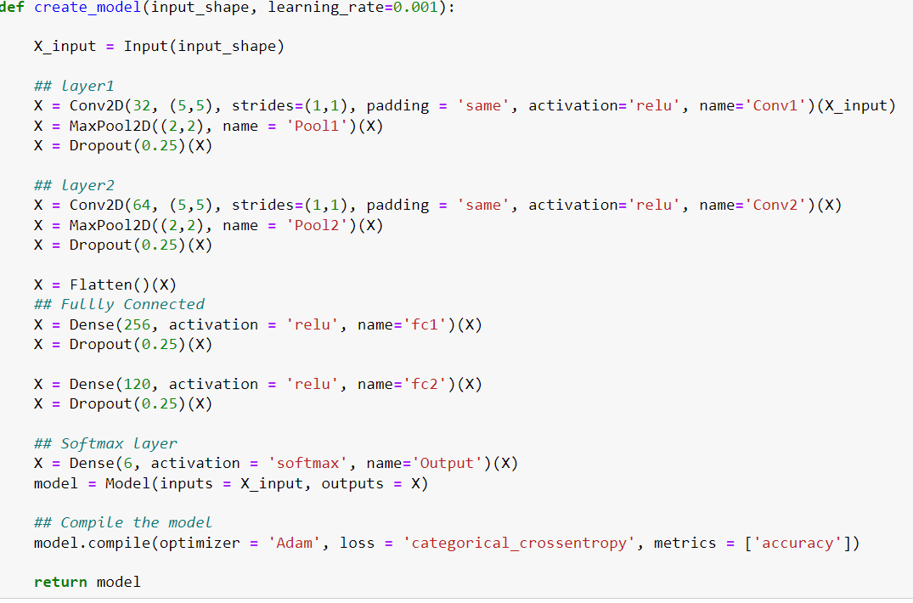
Creating CNN Model
Defines a function named create_model that takes two parameters:
input_shape: The shape of the input data, typically (height, width, channels).
Adds a convolutional layer with 32 filters of size (5,5), a stride of (1,1), and padding 'same'.
Applies ReLU activation.
Adds a max-pooling layer with pool size (2,2).
Applies dropout regularization with a rate of 0.25 to prevent overfitting.
Adds another convolutional layer with 64 filters of size (5,5), ReLU activation, max-pooling, and dropout.
Flattens the output from the convolutional layers into a 1D tensor to prepare for the fully connected layers.
Adds two fully connected (dense) layers with ReLU activation and dropout regularization.
Adds the output layer with 6 units (assuming it's a classification problem with 6 classes) and softmax activation.
Compiles the model using the Adam optimizer, categorical cross-entropy loss function (suitable for multi-class classification), and accuracy as the evaluation metric.

Slide 11
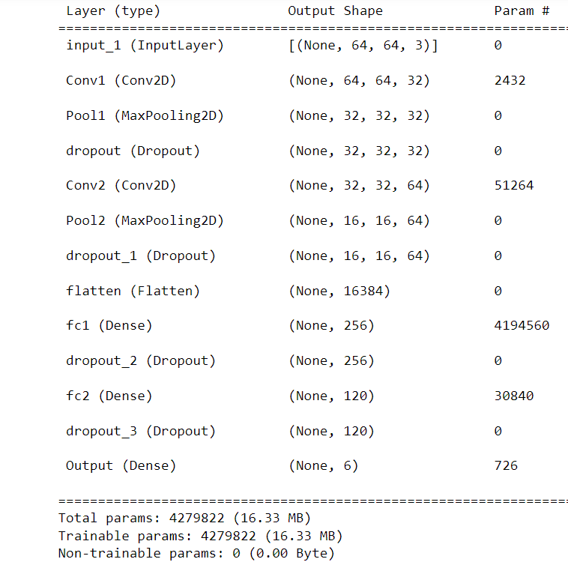
Summary of Model
The model consists of various layers, including:
InputLayer: Accepts input data with dimensions 64x64x3 (representing an image with 64x64 pixels and 3 color channels).
Conv1 (Conv2D): A convolutional layer with 32 filters.
Pool1 (MaxPooling2D): A max-pooling layer that reduces the spatial dimensions.
Dropout: A regularization layer that randomly drops some neurons during training.
Conv2 (Conv2D): Another convolutional layer with 64 filters.
Pool2 (MaxPooling2D): Another max-pooling layer.
Flatten: Flattens the output for the fully connected layers.
Fully Connected Layers (Dense):
fc1: 256 neurons.
fc3: 120 neurons (output layer with 6 classes).
The total number of trainable parameters in this model is 4,279,822

Slide 12
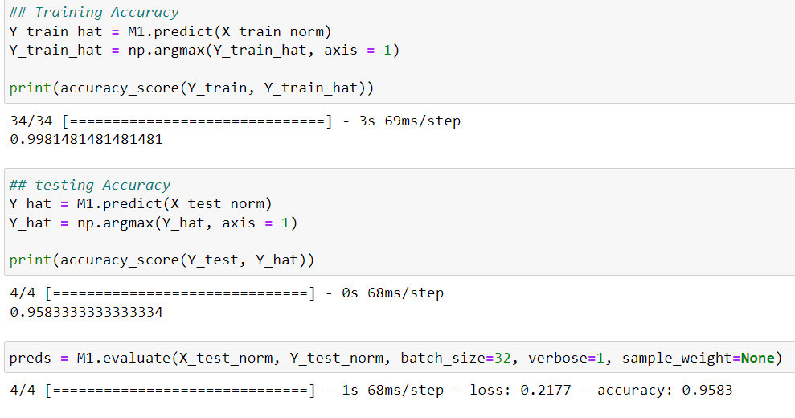
Accuracy and Prediction of the model
The training accuracy is approximately 99.81%.
The testing accuracy is approximately 95.83%
The model's performance is assessed using the evaluate method on the test data, revealing a loss of 0.2177 and an accuracy of roughly 95.83%.

Slide 13
Future Scope
The future scope of finger sign detection through Convolutional Neural Networks (CNNs) is promising, with potential applications in real-time gesture recognition, multimodal integration for enhanced robustness, and accessibility technologies for individuals with disabilities. Advanced CNN architectures and optimization techniques can improve accuracy and enable translation of finger signs into text or speech, benefiting healthcare, rehabilitation, and assistive technology domains. Privacy-preserving approaches are also important for ensuring user anonymity and data security. Continued research and innovation in CNN-based finger sign detection holds great potential for advancing human-computer interaction, healthcare, and societal inclusivity.

Slide 14
Conclusion
In conclusion, a successful project on finger detection through CNNs requires careful attention to data preparation, model architecture, hyperparameter tuning, evaluation metrics, deployment considerations, and continued improvement. By addressing these aspects diligently, one can develop an accurate and robust finger detection system that can be deployed in various real-world applications.

Slide 15
THANK YOU!!

